Slide 1
WP5
Virtual Neutron and Photon Laboratory
Carsten Fortmann-Grote, Juncheng E, Mads Bertelsen, Shervin Nourbakhsh, Mousumi Upadhyay Kahaly, Zsolt Lécz, Aljosa Hafner
Notes:
1. Participate in the construction of the EOSC by linking with the e-infrastructures and other ESFRI clusters.
Highlight: links to EOSC (WP6+WP8), e-infrastructures (WP6) + clusters (WP9)
2. Make scientific data produced at Europe’s major Photon and Neutron sources fully compatible with the FAIR principles.
Highlight: adoption of FAIR data policy (WP2) , search API (WP3) , reproducible science (WP4+WP5)
3. Generalise the adoption of open data policies, standard metadata and data stewardship from 15 photon and neutron RIs and physics institutes across Europe.
Highlight: FAIR data policy (WP2) , standard metadata + catalogues (WP3)
4. Provide innovative data services to the users of these facilities locally and the scientific community at large via the European Open Science Cloud (EOSC).
Highlight: Jupyter + Binder services, HDF5 tools (WP4 + WP5), simulation services (WP5), data transfer (WP6)
5. Increase the impact of RIs by ensuring data from user experiments can be used beyond the initial scope.
Highlight: User stories presented in demos (WP4 + WP5), training (WP8)
6. Share the outcomes with the national RIs who are observers in the proposal and the community at large to promote the adoption of FAIR data principles, data stewardship and the EOSC.

Slide 2
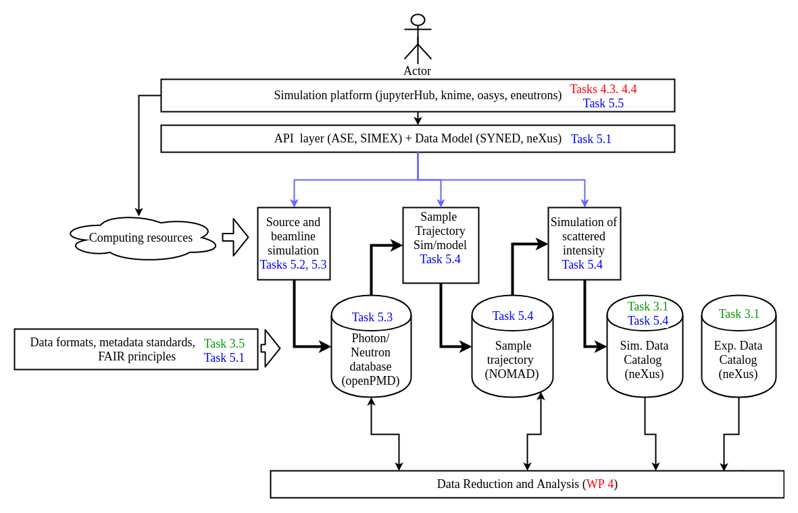
A simulation platform for P&N science
Key Components
SIMEX: Photon Experiment Simulation platform
McStas: Neutron Raytracing engine
OASYS: X-ray optics simulation environment
OpenPMD: Metadata standard for particle-mesh data
NEXUS: Metadata standard for experiments
Jupyter: Notebook based data analysis and computation platform

Slide 3
Experiment Simulation services add value to
RI Users:
  Support beamtime propopals
  Assist in setting up experimental configurations
  Estimate data quality, volume, scope, and range
RI operators:
  Optimize beamline optics by maximizing data yield and quality
  Validate beamtime proposals
Students:
  Simulations in E-learning platform (→ WP8)
PaNOSC Project:
  Provide realistic test data for other work packages (→ WP4)

Slide 4
Experiment Simulations foster adoption of FAIR Data principles
Findable, Accessible simulation data
  We investigate solutions for storage and provision of simulation data for standardized setups
  → Standardized data and metadata formats
  → Open data portals for simulation data
  → Search and filter based on simulation metadata
Interoperable simulation modules
  Our simulation pipelines rely on standardized data interfaces to allow seamless connectivity between simulation modules
Reusable workflows
  Harmonized simulation API for self-documenting and self-contained workflows

Slide 5
Provision of Simulation Services
Jupyter notebook services
Preconfigured simulation workflows, maintained in ViNyL github repository
Accessible from cloud computing services (binder, jupyterHub)
Seamless connection to data analysis services (WP4)
Prototype: jupyterHub@Eu.XFEL/DESY, access provided through WP6 services (aai.egi.eu)
Remote Desktop services
Oasys x-ray optics simulation
User connects to cloud computing service
Open and run Oasys as if in local environment
Prototype: RAFEC@CERIC-ERIC, integrated into Elettra’s Virtual Unified Office

Slide 6
Milestones
No. | Title | WP | Due | Verification | Status
MS5.1 | Simulation codes in PaNData Software Catalog | 5 | M6 | PaNData software catalog website | Done
MS5.2 | Demonstration of simulation services | 5 | M24 | Written report | In Progress
MS5.3 | VINYL software release | 5 | M42 | Software released via open source repository
MS5.4 | Validation of simulation services | 4,5 | M48 | Written report

Slide 7
Deliverables
No. | Title | Due | Verification | Status
D5.1 | Prototype simulation data formats as openPMD domain specific extensions including example datasets | M12 | Written report | Done
D5.2 | Release of documented simulation APIs | M24 | Software | In Progress
D5.3 | Repository of documented jupyter notebooks and Oasys canvases showcasing simulation tasks executable via JupyterHub or remote desktop. | M42 | Software | Start after D5.2
D5.4 | VINYL software tested, documented, and released, including integration into interactive data analysis workflow with feedback loop. | M48 | Written report + Software | Start after integration

Slide 8
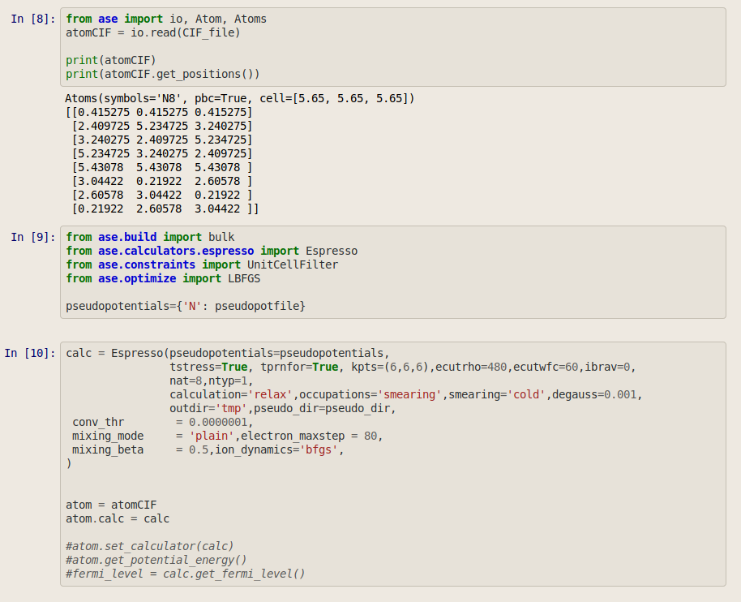
Example: Neutron simulation service
Target simulation with Density- Functional Theory (ASE interface to QuantumEspresso)
Neutron beam transport and diffraction simulation with McStas/McStas-Script

Slide 9
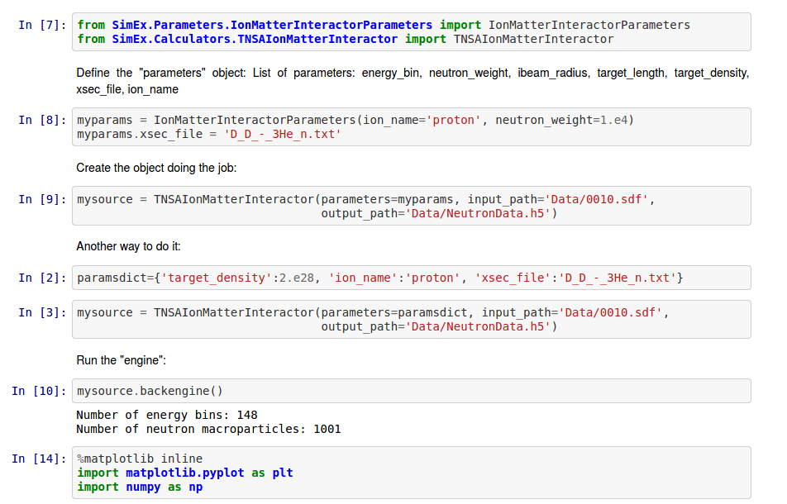
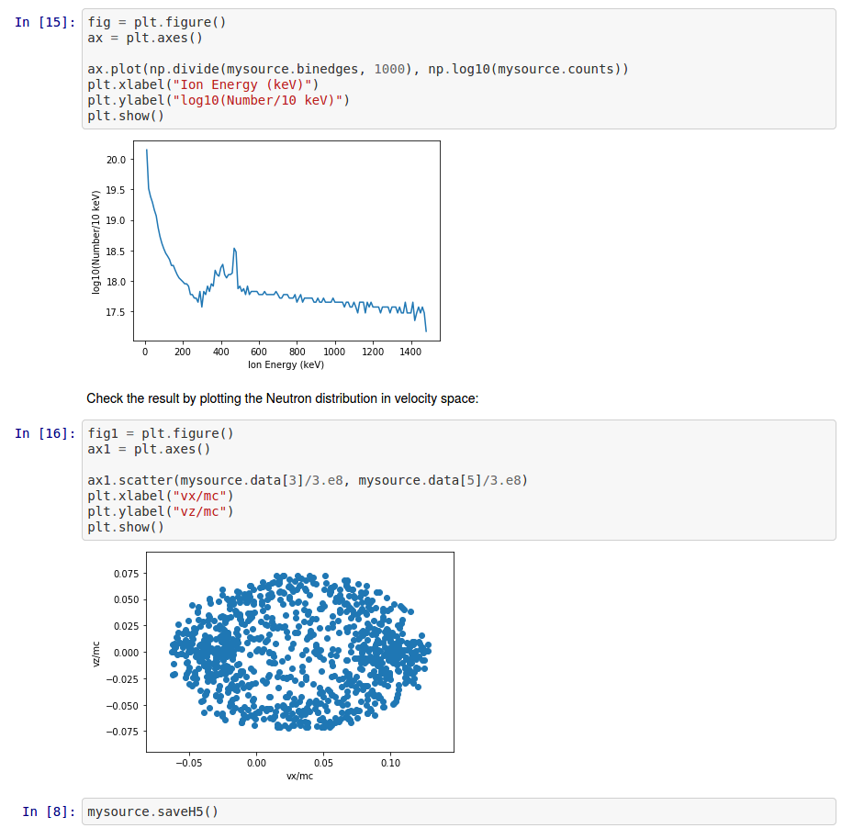
Examples
Jupyter notebook services
X-ray diffraction experiments at Free Electron Lasers
X-ray diffraction experiments at Synchrotrons
Neutron diffraction at conventional neutron sources
Density Functional Theory Target simulations
Neutron diffraction with high-power laser generated neutron

Slide 10
Summary
Simulations provide core data service for photon and neutron scientists
The two major backbone infrastructure components are
  delivered: Standardized data interfaces → openPMD, D5.1
  in progress: Simulation API → pyvinyl, D5.2
Application examples demonstrate the usability and flexibility of our simulation environment.

Slide 11
Thank you!
carsten.grote@xfel.eu

